Slide 1
Name: Itohowo Charles
University: Obafemi Awolowo
Email: itycharles@gmail.com
Country: England Specialization: Data ScienceBatch Code: LISUM12
Date: 25 August 2022
Submitted to: Data Glacier

Slide 2
Outline
Problem Statement
System Architecture
Result Evaluation
Application Design
Conclusion
Reference

Slide 3
Problem Statement
The term hate speech is understood as any type of verbal, written or behavioral communication that attacks or uses derogatory or discriminatory language against a person or group based on what they are, in other words, based on their religion, ethnicity, nationality, race, color, ancestry, sex or another identity factor. In this problem, we will take you through a hate speech detection model with Machine Learning and Python.
Hate Speech Detection is a task of sentiment classification. So, for training, a model that can classify hate speech from a certain piece of text can be achieved by training it on data that is used to classify sentiments. So, for the task of the hate speech detection model, we will use Twitter tweets to identify tweets containing Hate speech.

Slide 4
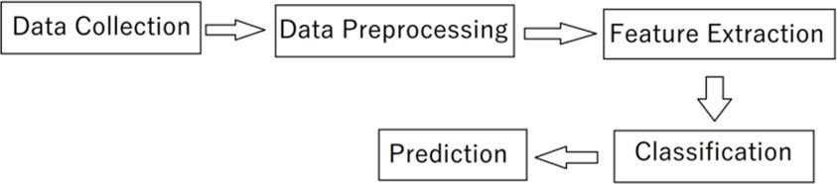
System Architecture
Figure 1: System Architecture

Slide 5

Data Collection
The Data is about Twitter hate Speech taken from Kaggle [1] which contains the 3 number of features and 31962 number of observations. Dataset using Twitter data, it was used to research hate-speech detection. The text is classified as: hate-speech, offensive language, and neither. Due to the nature of the study, it is important to note that this dataset contains text that can be considered racist, sexist, homophobic, or offensive.

Slide 6
Data Preprocessing
Text Cleaning
Lowercase
Remove Punctuation
Remove URLs
Remove @tags
Remove Special Characters
Preprocessing Operations
Tokenization
Removing Stop Words
Lemmatization

Slide 7
Feature Extraction
TF-IDF Model
Creating the histogram
frequent words from dictionaries
TF Matrix
IDF Matrix
TF-IDF Calculation

Slide 8

Deep Learning Model
CNN with LSTM Model

Slide 9
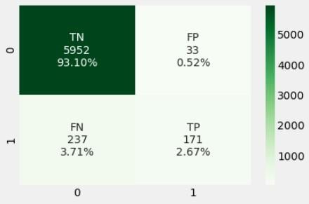
Result Evaluation
Confusion Matrix Visualization

Slide 10
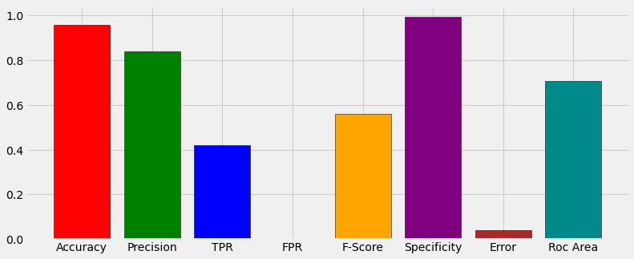
Result Evaluation (Cont'd)
Result Visualization

Slide 11
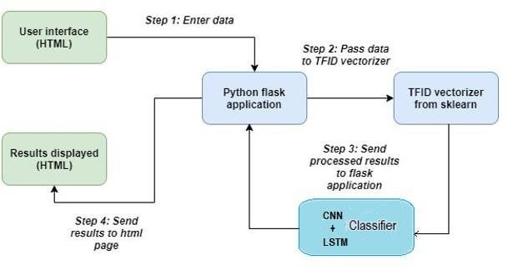
Application Design
Figure 3: Application Design

Slide 12

Application Design

Slide 13
Conclusion
The goal of this project was to find capable methods and settings that could be used to help detection of Hate and Free Speech on twitter. The error rate of the model is not zero, so still, some incorrect can be classified as true by the model. In future, we will enhance this work by implementing Temporal Convolutional Network (TCN) and Random Multimodel Deep Learning (RMDL) Techniques.

Slide 14
Reference
https://www.kaggle.com/datasets/vkrahul/twitter-hate- speech?select=train_E6oV3lV.csv
https://colah.github.io/posts/2015-08-Understanding-LSTMs/
Donahue, J., Hendricks, L. A., Rohrbach, M., Venugopalan, S.,
Guadarrama, S., Saenko, K., &amp; Darrell, T. (2016, May 31). Long- term recurrent convolutional networks for visual recognition and description. arXiv.org. Retrieved May 8, 2022, https://arxiv.org/abs/1411.4389

Slide 15
Thank You☺

